Slide 1


INSURANCE
PROPERTY & CASUALTY
HEALTH
AUTOMOBILES
LIFE
TRAVEL

Slide 2





Fraud detection by analysing the risk
Price Optimisation
Customer Segmentation
Lifetime values of customer by forecasting
Transparent claims management and Premium prediction

Slide 3
10540.695094537085
10540.695094537085
01
02
03
Size of the actual data :
(1048575, 33)
Duplicate values in the dataset :
(1793, 33)
After dropping the duplicate values: (1046782, 33)
04
05
Payment_typology_3 , Payment_typology_2 has the highest percentage of missing value
Average loss due to false claim
10540$

Slide 4
Dataset variable | Insights
'Area_service' | There are seven unique value
'Hospital county' | Keep it as extra variable if the data accuracy is low let’s use this variable
'Certificate_num' | Since we have only 128 unique number its indicating something so let’s keep
'Hospital name' | Keep it as extra variable
'Age' | Since we have range of age let’s do one hot encoding
'Zip_code_3_digits' | Since the zip code in object and each zip code may tell a story let’s convert it as integer value
'Gender' | Encoding can be done
'Cultural_group' | race of people
'Ethnicity' | 210 unique values
'Days_spend_hsptl' | Since days spent is numbers its in object let’s convert it into integer
'Admission_type' | Urgent/ Elective/ Emergency etc.
'Home or self care,' | 19 unique number hot encoding
'Ccs_diagnosis_code' | Keep it as an integer value
'Ccs_procedure_code' | Keep it as an integer value
'Apr_drg_description' | There are 316 unique value we can do label encoding if required or let’s keep it as option variable
'Apr_mdc_description' | There are 316 unique value we can do label encoding if required or let’s keep it as option variable
'Code_illness' | Its integer value
'Weight_baby' | its integer
'Emergency dept_yes/no' | Yes / No
'Tot_charg' | Its float let’s keep
'Tot_cost' | Its float let’s keep
'Ratio_of_total_costs_to_total_charges' | Its float let’s keep
'Result' | Output variable (Y)

Slide 5
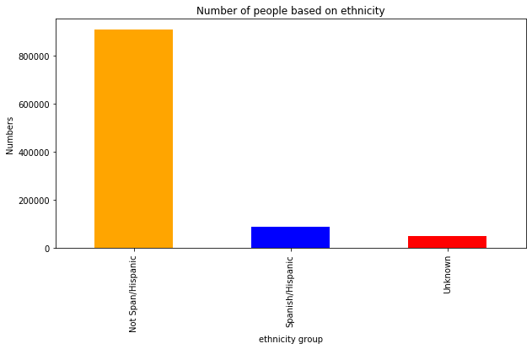
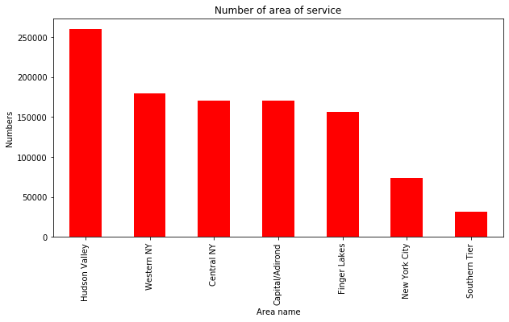
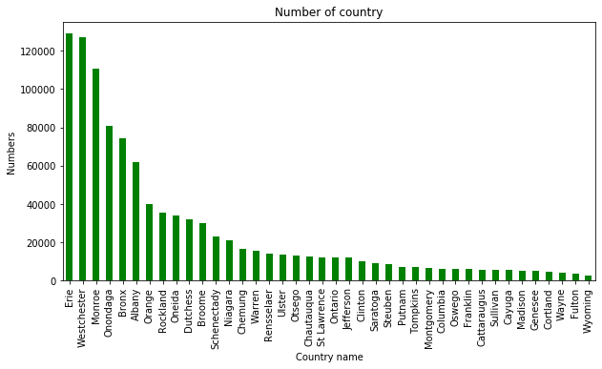
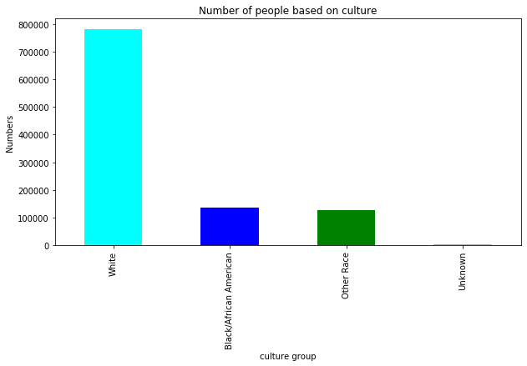
Number of people base on ethnicity( race of people)
Number of people based on service in each area
Number of county name
Number of people based on culture group i.e., race of people

Slide 6
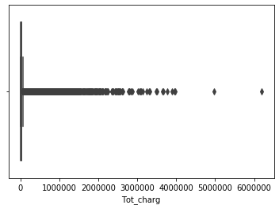
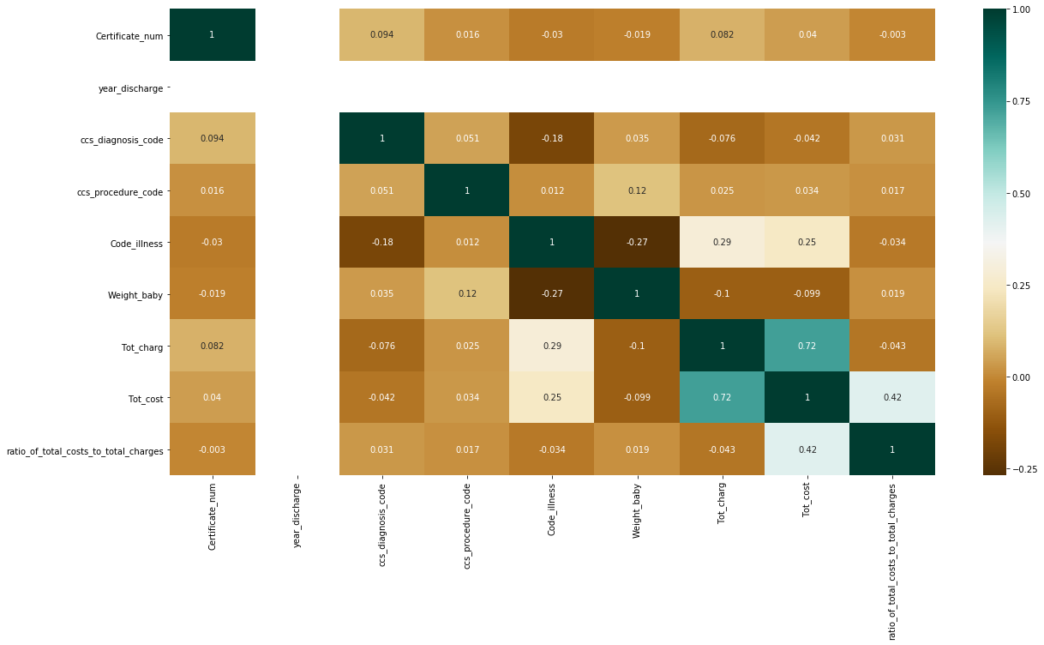
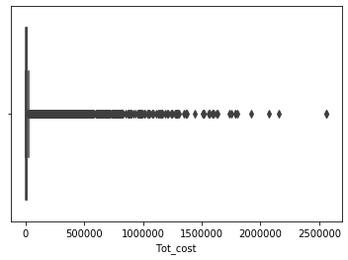
Number of total charge
Correlation between variables
Outlier is present in total charge
Number of total cost
Outlier is present in total charge
Based on the colour we can find the correlation between variable

Slide 7
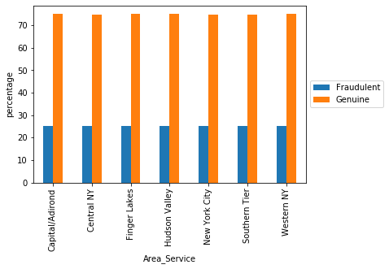
Comparison Between Area Spent Vs Result
Result | Fraudulent | Genuine
Area_Service
Capital/Adirond | 25.01 | 74.99
Central NY | 25.05 | 74.95
Finger Lakes | 25.02 | 74.98
Hudson Valley | 25.00 | 75.00
New York City | 25.06 | 74.94
Southern Tier | 25.06 | 74.94
Western NY | 25.01 | 74.99

Slide 8
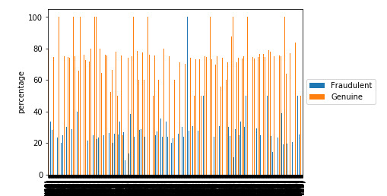
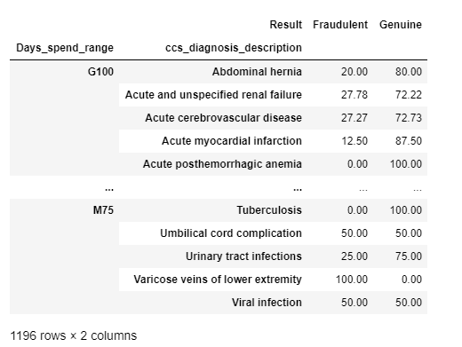
Comparison Between Ccs_description New Column Day_spent_range With Result
Ccs description is ICD code which tells us the patients diagnosis based on code and Days spent we have categorised based on few intervals range to see how many days they spend time in hospital
here we see the patient who spent there days using the diagnosis description.
We have created a new column based on the range of days that are spent in hospital
M0 – patient spent 0 to 10 days
M10 – patient spent 10 to 25 days
M25– patient spent 25 to 50 days
M75 – patient spent 50 to 75 days
M100– patient spent 75 to 100 days
G100 – patient spent greater than 100

Slide 9
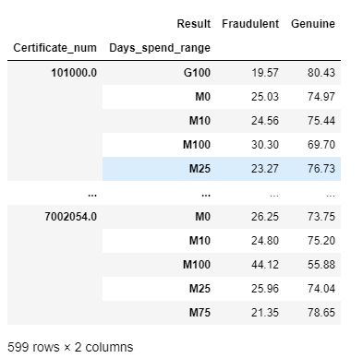
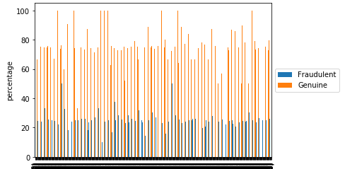
Comparison Between Certificate Num New Column Day_spent_range With Result
Certificate number is unique number which helps us to know the claimant details under which group or category the diagnosis was and we created a new column ‘Days spent’ and we have categorised based on few intervals range to see how many days they spend time in hospital
Here we see the days spent vs certificate num

Slide 10
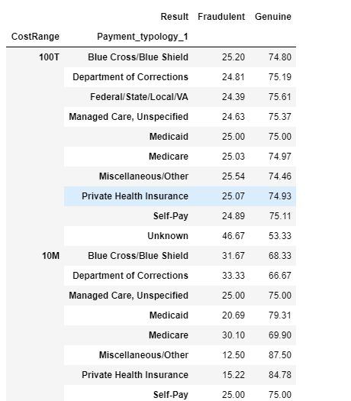
Comparison between payment typology new column cost_range with Result
We have created a new column based on the range of days that are spent in hospital
T – cost in thousand
10T – cost in ten thousand
100T – cost in hundred thousand
1M – cost in million
10M – cost in 10 million
100M – cost in 100 million
Ccs description is ICD code which tells us the patients diagnosis based on code and Days spent we have categorised based on few intervals range to see how many days they spend time in hospital
here we see the patient who spent there days using the diagnosis description.

Slide 11
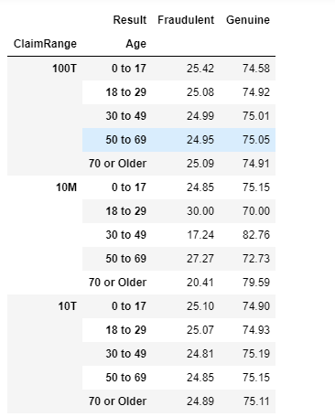
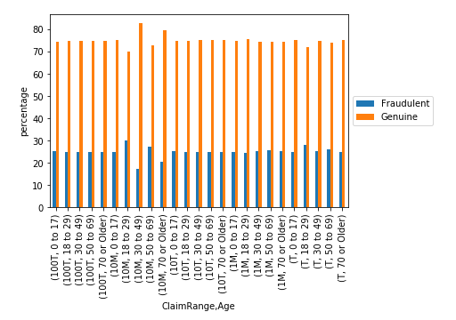
Comparison between payment typology new column claim_range with Result

Slide 12
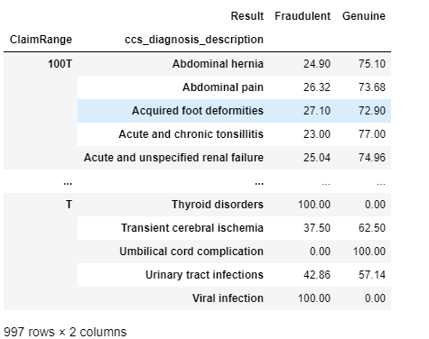
Comparison Between Ccs_description New Column Claim_range With Result

Slide 13
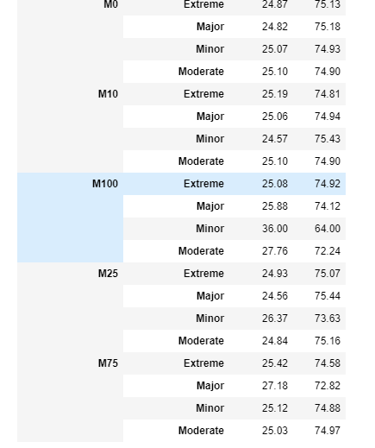
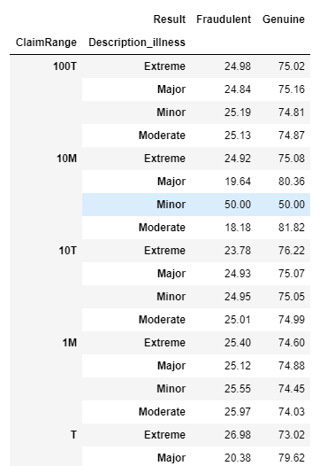
Compare Day_spent_range With Illness Description

Slide 14
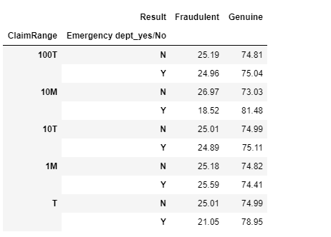
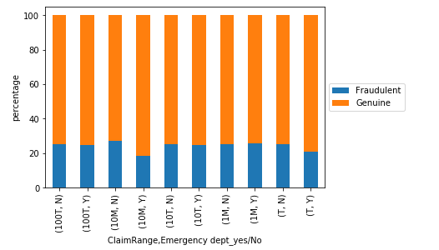
Emergency And Claim Cost Range

Slide 15
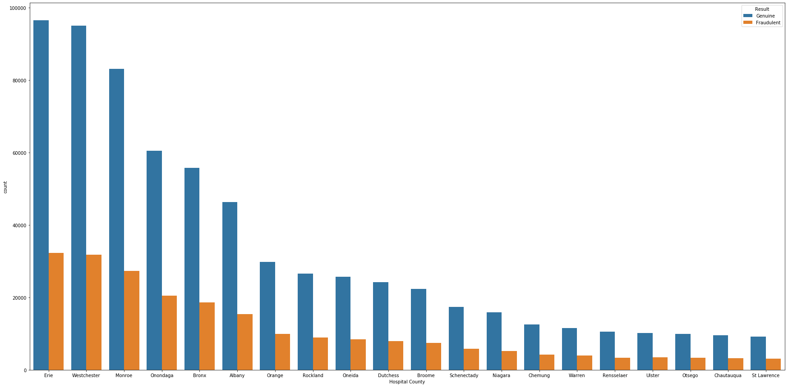
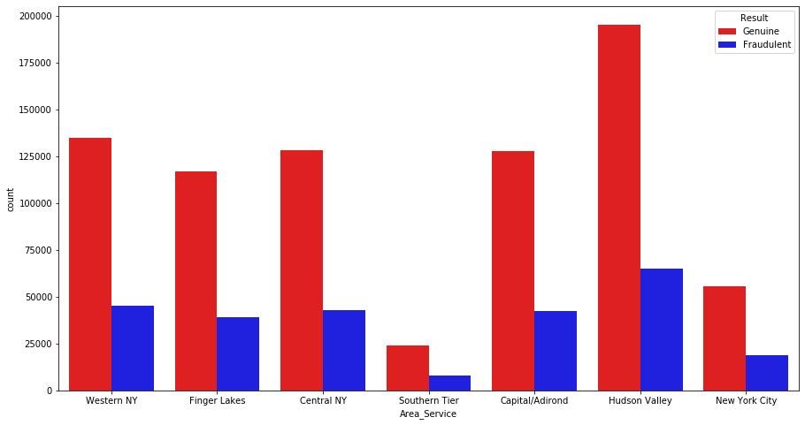
Number of hospital county vs target (fraudulent and genuine)
Service area vs target (fraudulent and genuine)

Slide 16
Data Modelling – Data splitting
Predictive model building involves splitting of data set into train and test this is to ensure that our model helps in validating against the data.
Training set (70%) and testing set (30%)
Dependent variable ‘Result’
By dropping duplicates and creating new dummy variables we have split the data into test and train.
Logistic regression with Principle component analysis
By normalising the data using standard scaler we reduce the dimension in pca so that we get a better visualisation of our data
from sklearn.decomposition import PCA
pca=PCA()
pc=pca.fit_transform(new)
pca_df=pd.DataFrame(pc)
xtrain,xtest,ytrain,ytest=train_test_split(pca_df,dummy[result])
m=LogisticRegression() model=m.fit(xtrain.iloc[:,0:4],ytrain)
pred=model.predict(xtest.iloc[:,0:4])
np.mean(pred==ytest)
The Accuracy = 75%

Slide 17
KNN – k nearest neighbour
As we all know that in knn we find the distance between query, we have done a knn fit to find the accuracy level.
Random Forest
By using random forest we got the accuracy level of 72
from sklearn.neighbors import KNeighborsClassifier
knn = KNeighborsClassifier(n_neighbors=3)
model1=knn.fit(xtrain.iloc[:,0:4],ytrain) pred=model1.predict(xtest.iloc[:,0:4])
np.mean(pred==ytest)
The Accuracy = 73%
from sklearn.ensemble import RandomForestClassifier
rf=RandomForestClassifier()
model=rf.fit(xtrain.iloc[:,0:4],ytrain)
pred=model.predict(xtest.iloc[:,0:4])
np.mean(pred==ytest)
The Accuracy = 72%

Slide 18
SL NO | MODEL | OVERALL ACCURACY | PRECISION |  | RECALL |  | F1 SCORE |  | SENSTIVITY | SPECIFICITY | TESTING SAMPLE SIZE
 |  |  | Fraud | Genuine | Fraud | Genuine | Fraud | Genuine
1 | LOGISTIC REGRESSION WITH PCA | 0.750825385
2 | RANDOM FOREST
3 | KNN
4 | DECISION TREE | 0.6141362 | 0.750523295
5
6
7
8
9
10

Slide 19
CONFUSION MATRIX
Logistic Regression with PCA
array([[ 0, 65208],
[ 0, 196488]], dtype=int64)
Decision Tree
array([[ 17653, 47555],
[ 53424, 143064]], dtype=int64)

Slide 20
Final Deployment
After final model as been selected (KNN algorithm)
We have deployed using flask and front end (html)
Front end as two page
Index or home page :- where end user can enter all the required

